Slide 1
Stats for Grad Students: Lecture #7
Interactions in regression models
Centering, scaling (and other predictor transformations)
Logistic regression
(if time allows) Beyond two-way interactions

Slide 2
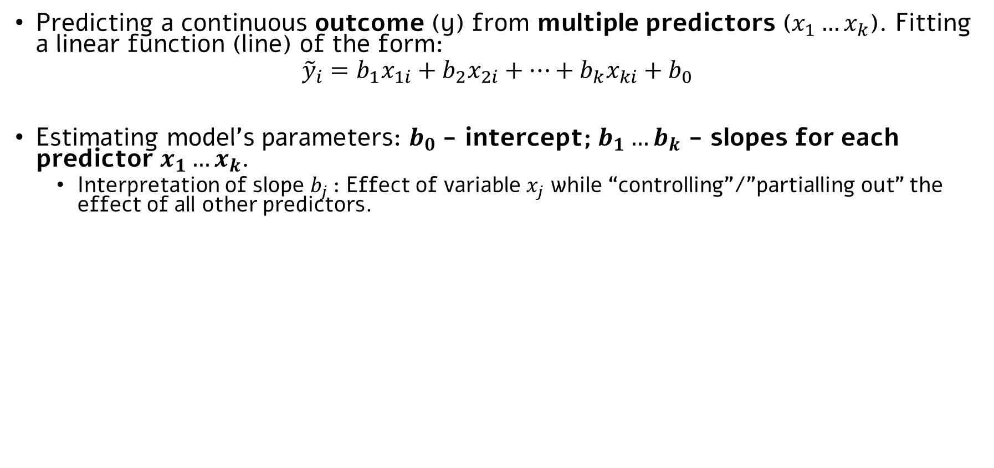
Reminder: Multiple linear regression
Predicting a continuous outcome (y) from multiple predictors ($x_{1}…x_{k}$). Fitting a linear function (line) of the form:
$${\tilde{y}}_{i}=b_{1}x_{1i}+b_{2}x_{2i}+…+b_{k}x_{ki}+b_{0}$$
Estimating model’s parameters: $b_{0}$- intercept; $b_{1}…b_{k}$ - slopes for each predictor $x_{1}…x_{k}$.
Interpretation of slope $b_{j}$: Effect of variable $x_{j}$ while “controlling”/”partialling out” the effect of all other predictors.
As always, we can use NHST procedures to draw inferences about these parameters (specifically, is $β_{1}$… $β_{k}$ different than zero? What is the 95% CI?)
Can estimate total $R^{2}$: proportion variance in y explained by $x_{1}…x_{k}$
Although $R^{2}$ is biased, hence we typically use adjusted- $R^{2}$
We learned how to code categorical variables to insert them into multiple regression models.

Slide 3
Reminder: Multiple linear regression
E.g., in a multiple regression model with two predictors:
Happiness (y)
The part explained by x1 in y, “controlling“ for or “partialling out” x2.
Used to compute b₁.
The part explained by x2 in y, “controlling“ for or “partialling out” x1.
Used to compute b₂.
Exercise hours (x1)
Hours in sun (x2)

Slide 4
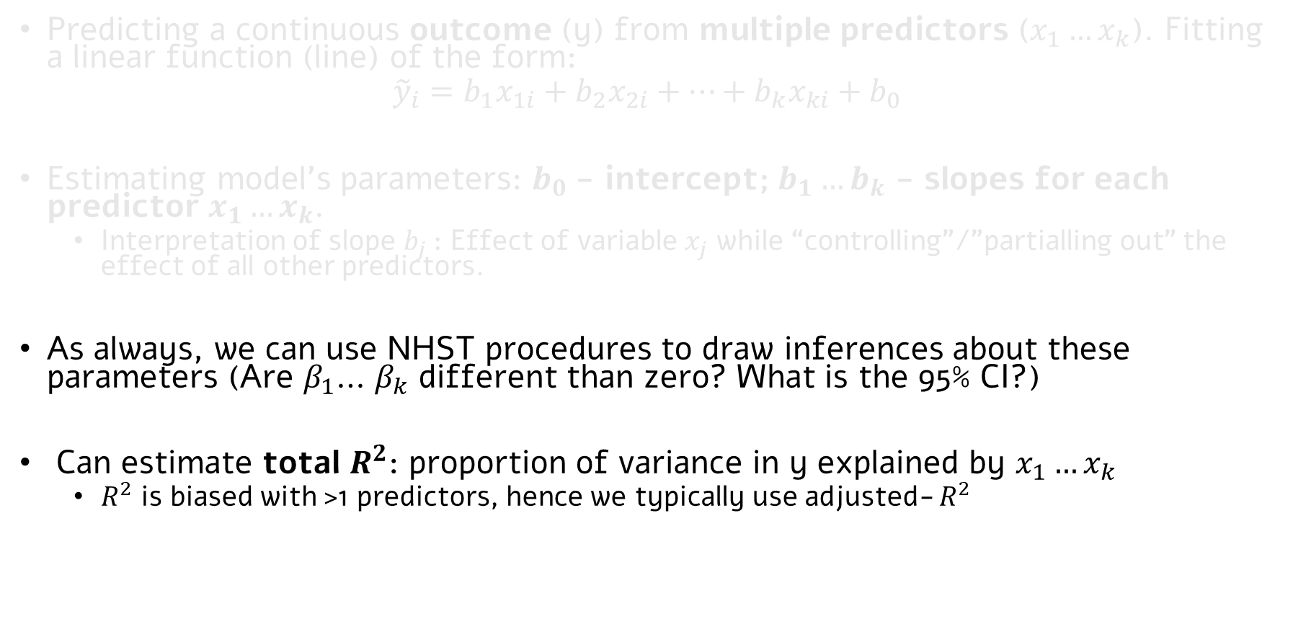
Reminder: Multiple linear regression
Predicting a continuous outcome (y) from multiple predictors ($x_{1}…x_{k}$). Fitting a linear function (line) of the form:
$${\tilde{y}}_{i}=b_{1}x_{1i}+b_{2}x_{2i}+…+b_{k}x_{ki}+b_{0}$$
Estimating model’s parameters: $b_{0}$- intercept; $b_{1}…b_{k}$ - slopes for each predictor $x_{1}…x_{k}$.
Interpretation of slope $b_{j}$: Effect of variable $x_{j}$ while “controlling”/”partialling out” the effect of all other predictors.
As always, we can use NHST procedures to draw inferences about these parameters (Are $β_{1}$… $β_{k}$ different than zero? What is the 95% CI?)
Can estimate total $R^{2}$: proportion of variance in y explained by $x_{1}…x_{k}$
$R^{2}$ is biased with >1 predictors, hence we typically use adjusted- $R^{2}$
We learned how to code categorical variables to insert them as predictors into regression models.

Slide 5
Reminder: Multiple linear regression
E.g., in a multiple regression model with two predictors:
Happiness (y)
The part explained by x1 AND x2 in y.
Used to compute total R² (and SSreg) of model.
Exercise hours (x1)
Hours in sun (x2)

Slide 6
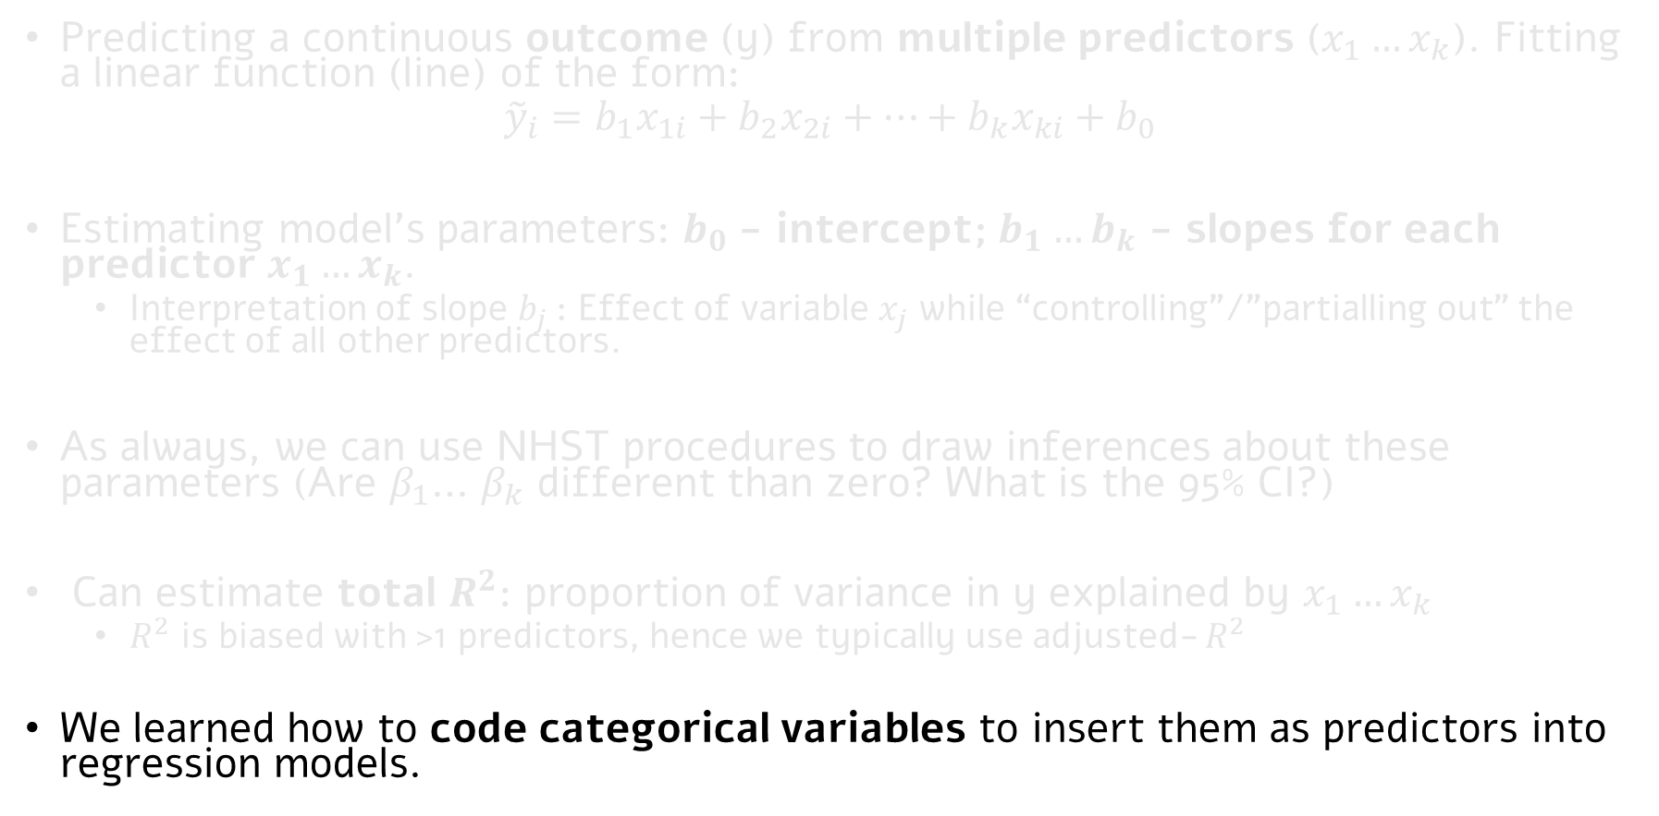
Reminder: Multiple linear regression
Predicting a continuous outcome (y) from multiple predictors ($x_{1}…x_{k}$). Fitting a linear function (line) of the form:
$${\tilde{y}}_{i}=b_{1}x_{1i}+b_{2}x_{2i}+…+b_{k}x_{ki}+b_{0}$$
Estimating model’s parameters: $b_{0}$- intercept; $b_{1}…b_{k}$ - slopes for each predictor $x_{1}…x_{k}$.
Interpretation of slope $b_{j}$: Effect of variable $x_{j}$ while “controlling”/”partialling out” the effect of all other predictors.
As always, we can use NHST procedures to draw inferences about these parameters (Are $β_{1}$… $β_{k}$ different than zero? What is the 95% CI?)
Can estimate total $R^{2}$: proportion of variance in y explained by $x_{1}…x_{k}$
$R^{2}$ is biased with >1 predictors, hence we typically use adjusted- $R^{2}$
We learned how to code categorical variables to insert them as predictors into regression models.

Slide 7
Interactions in regression models

Slide 8
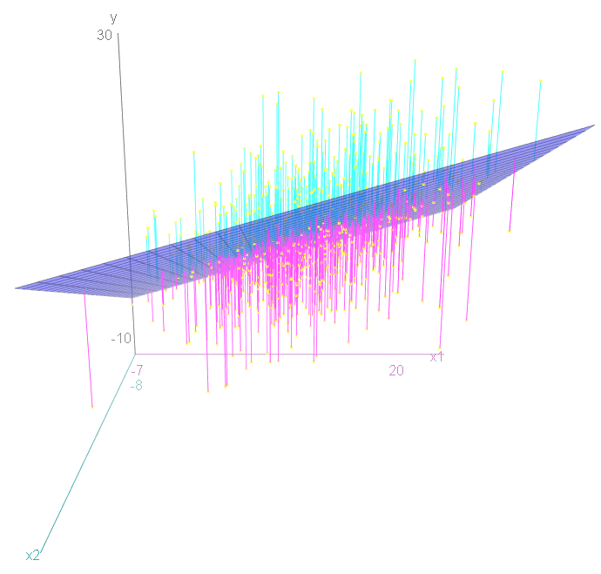
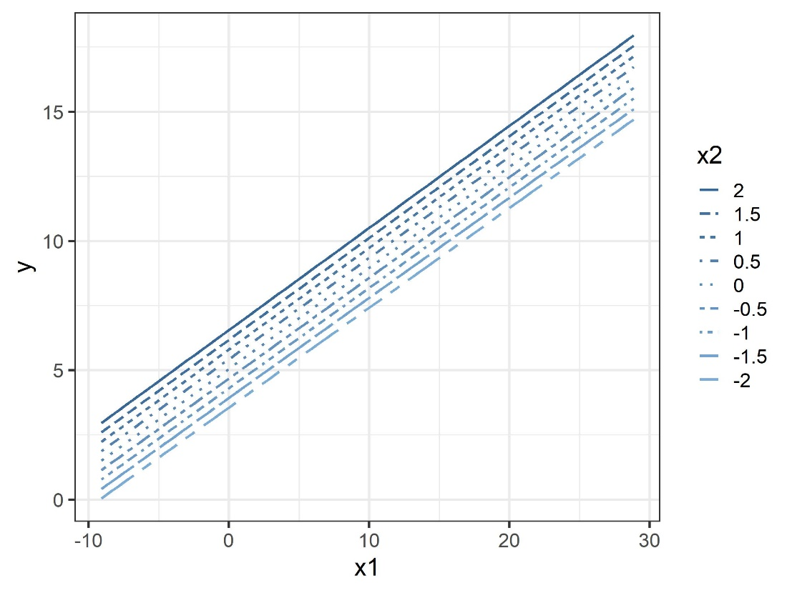
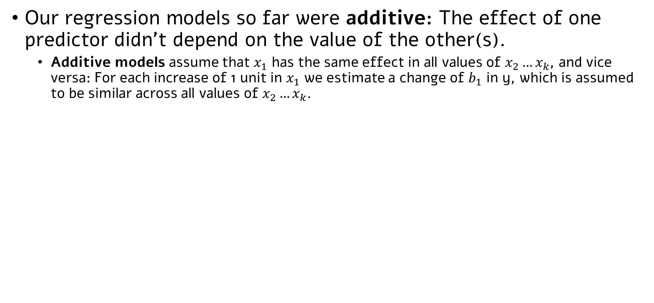
Interactions in regression models
Our regression models so far were additive: The effect of one predictor didn’t depend on the value of the other(s).
Additive models assume that $x_{1}$ has the same effect in all values of $x_{2}…x_{k}$, and vice versa: For each increase of 1 unit in $x_{1}$ we estimate a change of $b_{1}$ in y, which is assumed to be similar across all values of $x_{2}…x_{k}$.

Slide 9
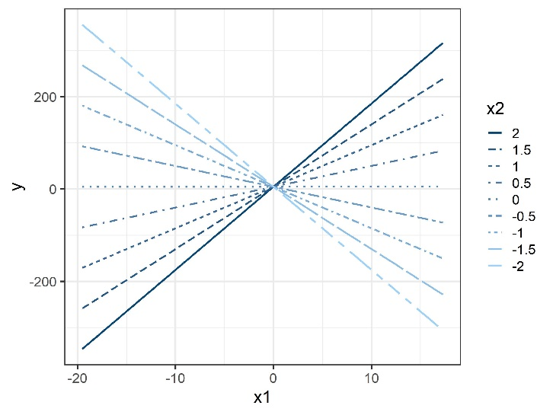
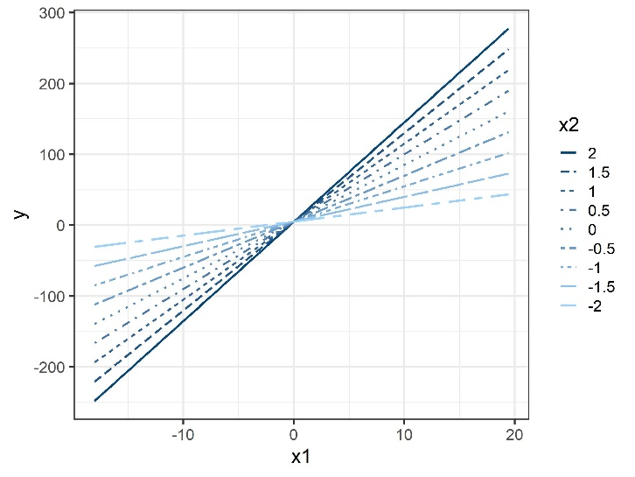
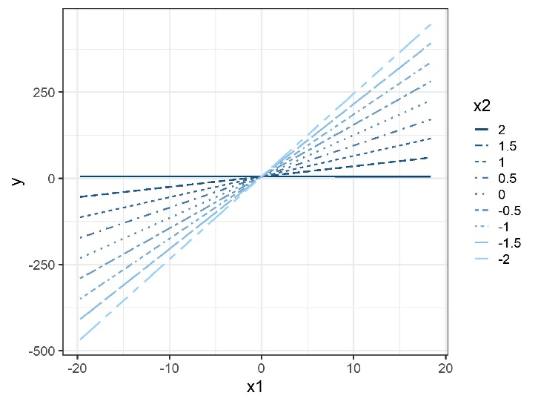
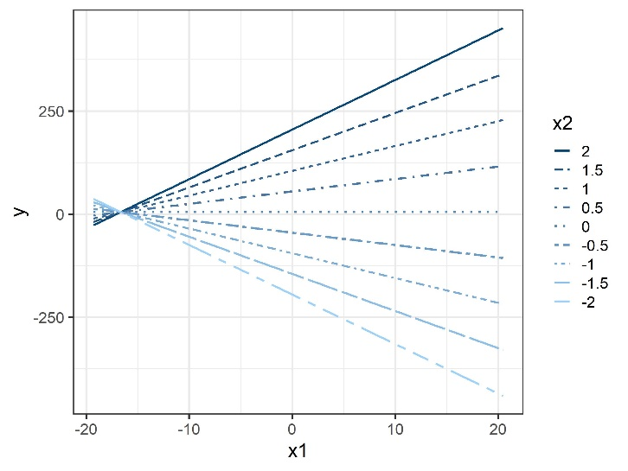
Interactions in regression models
Today, we will learn about interactive regression models: The effect of one predictor does (potentially) depend on the value of the other(s).
We will estimate a slope for an interaction term, to examine whether indeed the effect of one variable depends on a level of another.
Typically, in interactive models, we look both at the main effects, but in addition we examine the effect of an interaction: whether the effect of on predictor depends on the levels of another predictor.
This is very similar to what we already saw in two-way ANOVAs. As always, regressions are simply a more general and flexible approach, to which ANOVA is a special case.

Slide 10
Questions about interactions are very common… Over-using the happiness example
The effect of pet ownership (dog/cat/none) and housing type (house/apartment):
Dog > Cat > none (main effect of pet ownership)
No difference between people who live in house vs. apartment (no main effect of housing type)
Interaction: having a dog in a house increases happiness levels; having a dog in an apartment makes you less happy.
The effect of income ($0 … $100K annually) and work hours (0… 80 per week week):
People with more money are generally more happy (main effect).
People who work less hours are more happy (main effect).
Interaction: Among people who work lots of hours, making more money doesn’t increase happiness.
Exercise hours (0…20 hours/week) and type of activity (team/alone).
More exercise greater happiness (main effect)
People who exercise in groups are more happy (main effect)
Interaction: The effect of more exercise in greater when you work out in a group.
Interaction between two categorical predictors (categorical-categorical)
Interaction between two continuous predictors (continuous-continuous)
Interaction between a categorical and continuous predictor (categorical-continuous)

Slide 11
Questions about Interactions are very common… Over-using the happiness example
The effect of pet ownership (dog/cat/none) and housing type (house/apartment):
Dog > Cat > none (main effect of pet ownership)
No difference between people who live in house vs. apartment (no main effect of housing type)
Interaction: having a dog in a house increases happiness levels; having a dog in an apartment makes you less happy.
The effect of income ($0 … $100K annually) and work hours (0… 80 per week week):
People with more money are generally more happy (main effect).
People who work less hours are more happy (main effect).
Interaction: Among people who work lots of hours, making more money doesn’t increase happiness.
Exercise hours (0…20 hours/week) and type of activity (team/alone).
More exercise greater happiness (main effect)
People who exercise in groups are more happy (main effect)
Interaction: The effect of more exercise in greater when you work out in a group.
Interaction between two categorical predictors (categorical-categorical)
Interaction between two continuous predictors (continuous-continuous)
Interaction between a categorical and continuous predictor (categorical-continuous)

Slide 12
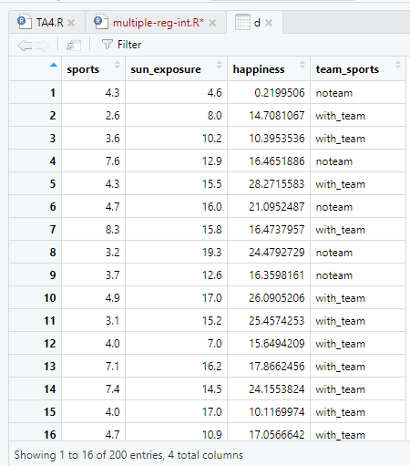
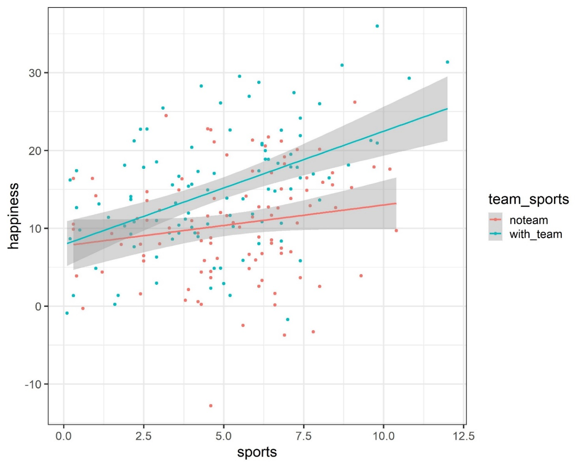
Plotting the raw* data *(=simulated. don’t use for life-changing decisions!)

Slide 13
Plotting the raw* data *(=simulated. don’t use for life-changing decisions!)
Predictions (assuming that all effects plotted are significant, i.e., “extreme enough” under H0; which they are, because they were simulated to be this way ☺):
Main effect I (continuous): People who exercise more are happier.
Main effect II (categorical): People who exercise in a group are happier.
Interaction: The effect of exercise hours is specifically (only?*) pronounced in individuals who work out in a team.
Or: The effect of working out in a team is more pronounced in higher amount of exercise hours. Remember: Interactions are symmetric!
Let’s assume that we want to test for the significance of these effects, while controlling for hours sun exposure.
(* Note: Testing whether there are ‘simple effects’ of exercise hours on happiness in either/both conditions require additional analyses – testing for ‘simple slopes’.
Can be done by looking at the effect of exercise hours in each team separately.)

Slide 14
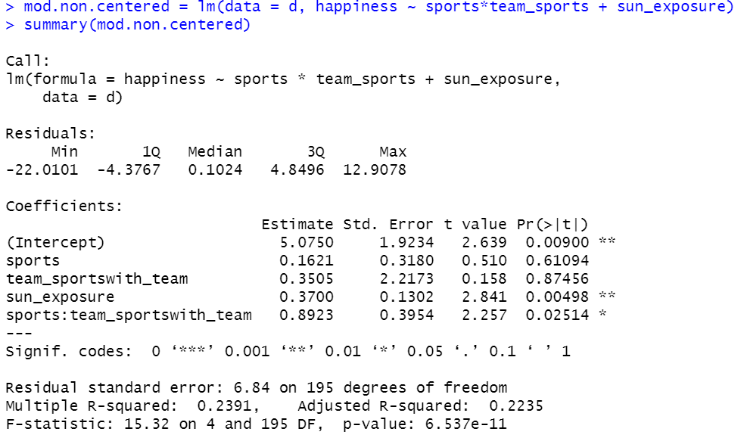
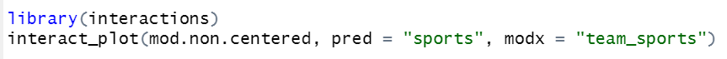
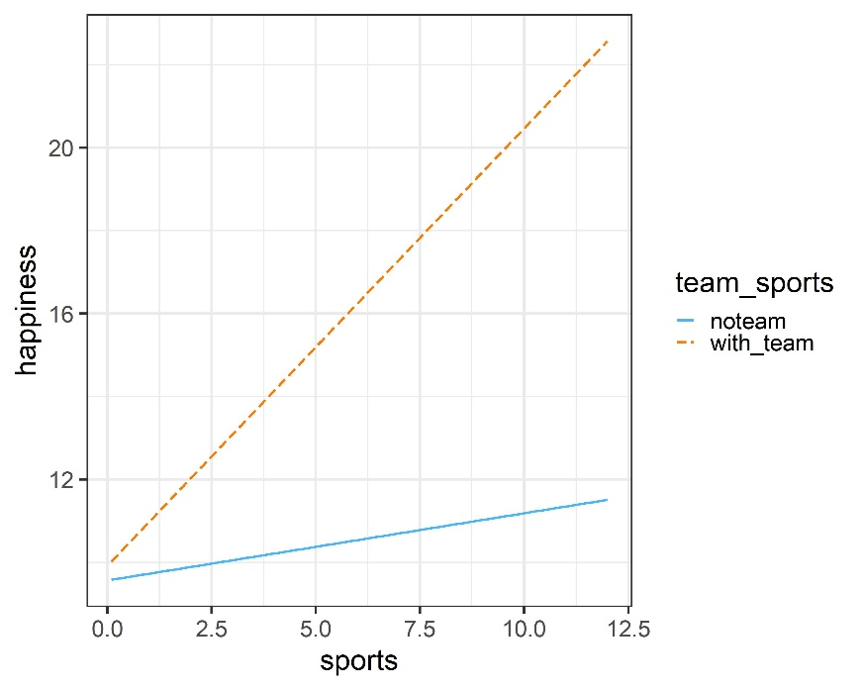
Running a model with an interaction - R
Voila! A significant interaction.
The effect of one independent variable (e.g., sports hours) on the dependent variable is different in varying levels of the other independent variable (e.g., team-sports).

Slide 15
Running a model with an interaction - R
But… what happened to the main effects?
Remember: In multiple regression, the effect of variable x1 is the effect when all other variables are set to 0.
When we didn’t have interactions (additive models), this wasn’t crucial – effect of x1 was assumed to be the same across values of other variables.
When interactions are included, we allow the effect of a variable to vary as a function of the levels of another.
When interaction between x1 and x2 are included –> main effect of variable 1 is its estimated effect when variable 2 is set to 0; main effect of var 2 is its estimated effect when var 1 is set to 0.

Slide 16
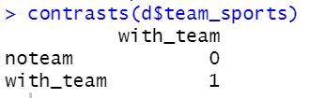
Running a model with an interaction - R
Main effect of team sports (yes/no): Estimated when number of sports hours is 0.
What about the main effect of sport hours?
Depends on the coding of team sports!
We haven’t changed default, hence its dummy-coding.
noTeam is set to 0; the effect of sport hours is estimated for that level, i.e., noTeam.

Slide 17
Centering independent variables
Sometimes (quite rarely) we actually want to estimate the main effects at the raw 0 level of the other variable.
But more often, we think of the overall effect of one variable as the effect on average, across levels of the other variable(s).
The solution: “Mean centering”: Making sure all variables included in interactive terms have a mean of 0.
Then, the effect of one variable(s) is estimated at the other variable’s grand mean.

Slide 18
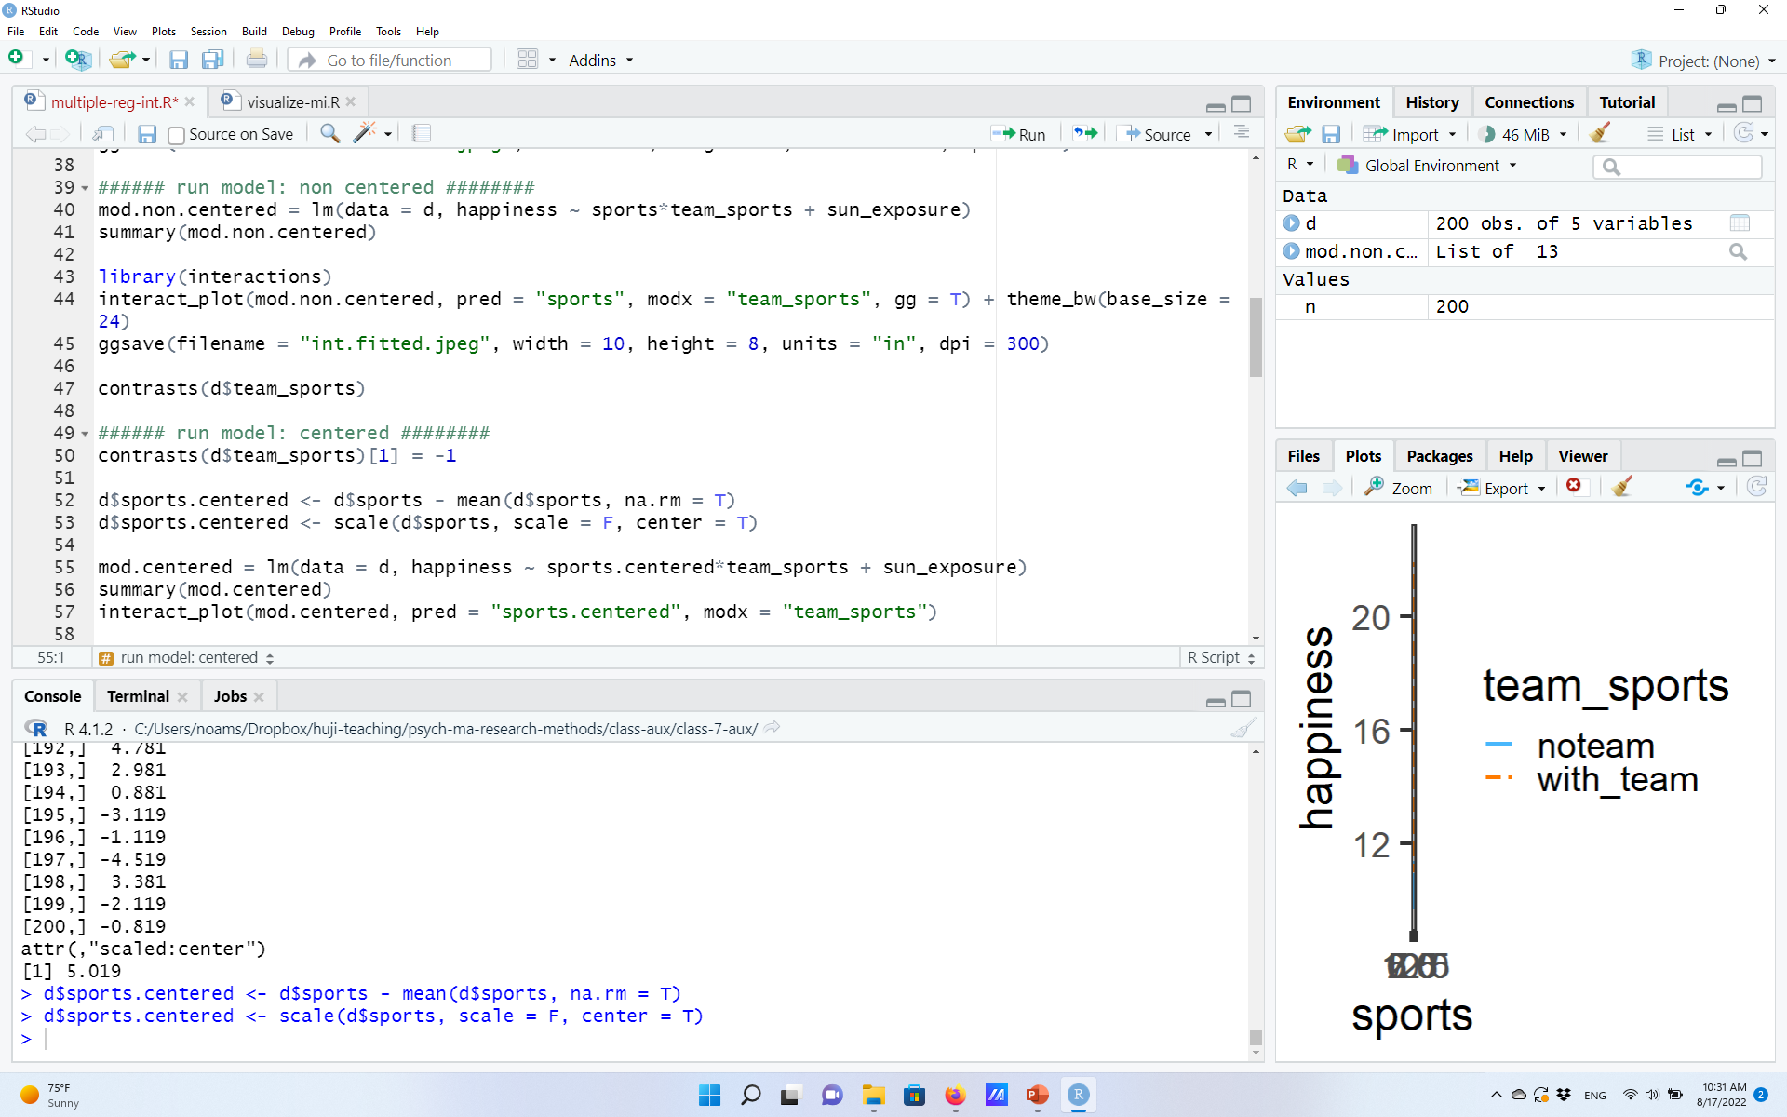
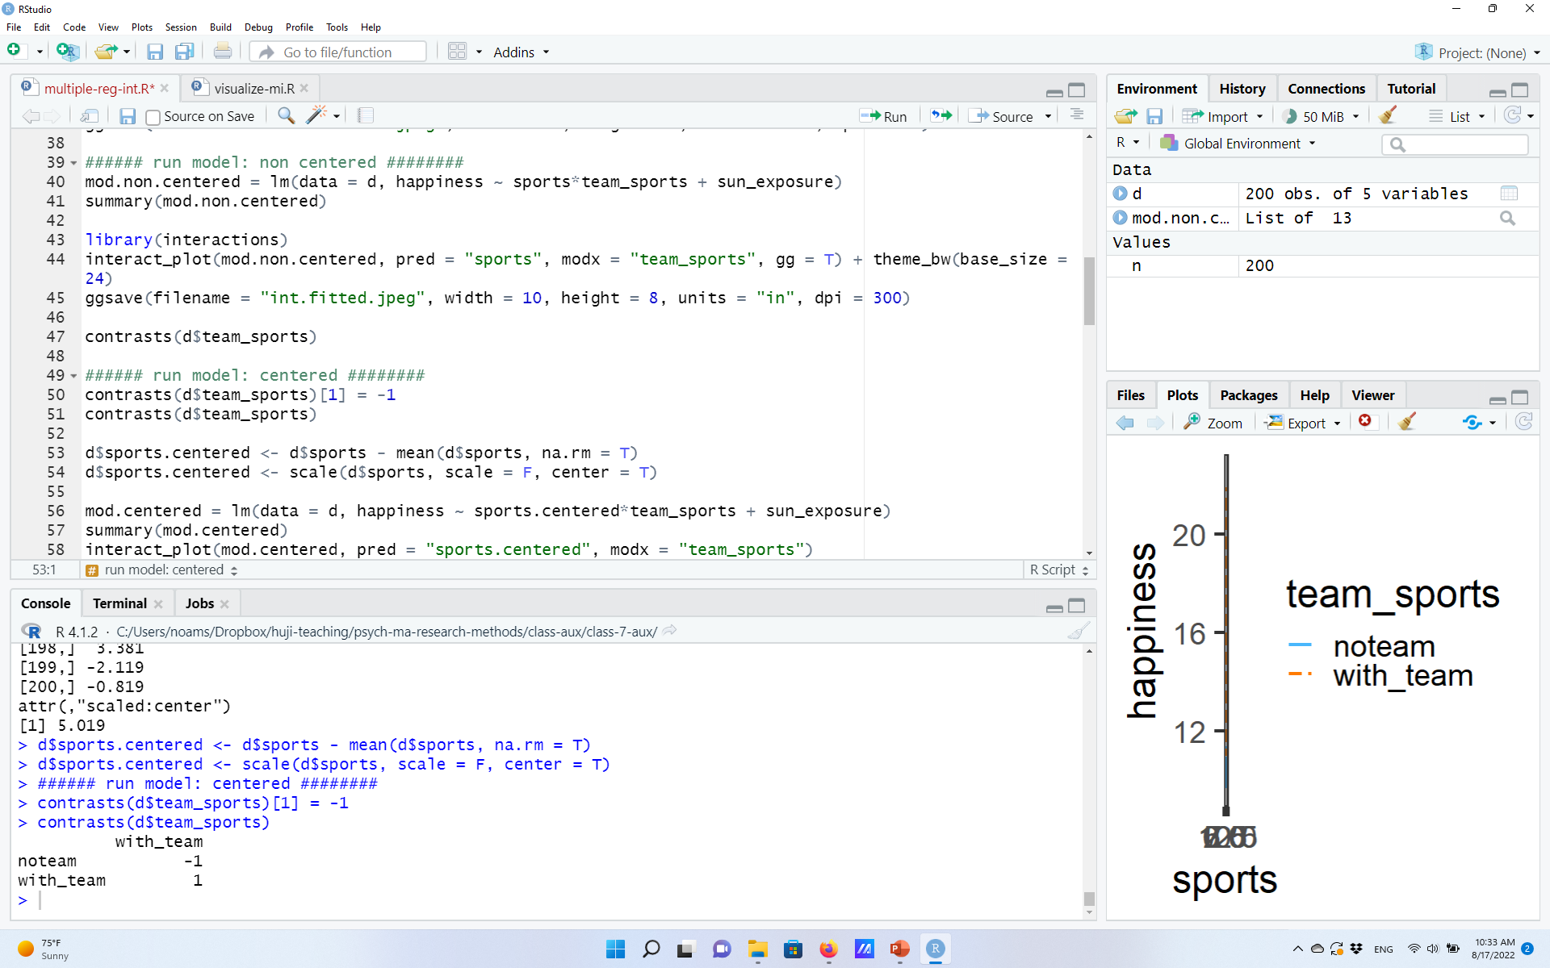
Centering (and scaling) independent variables
For continuous variables: subtract the mean:
Which is equivalent to:
What about categorical variables?
Use effect-coding!
(This assumes a similar number of observations of the different levels. If not, need to adjust the weights so that the mean is still 0.)

Slide 19
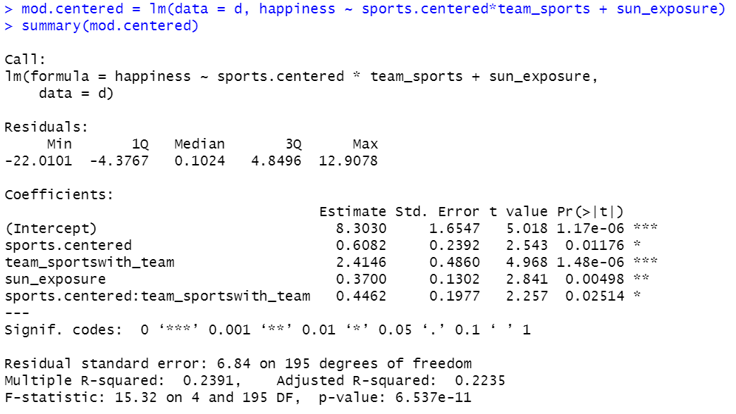
Centered vs. non-centered variables in a regression model
Non-centered model (raw predictors)
Centered model (centered predictors)
Centering does not affect the interaction’s B, SE, t, and p, nor the full model’s significance/R²
Centering does affect the estimates of the main-effects (B, SE, t, and p).

Slide 20
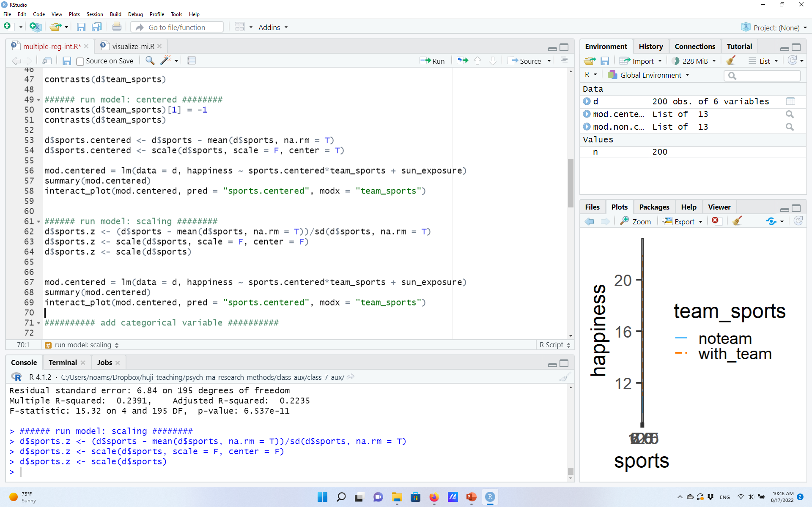
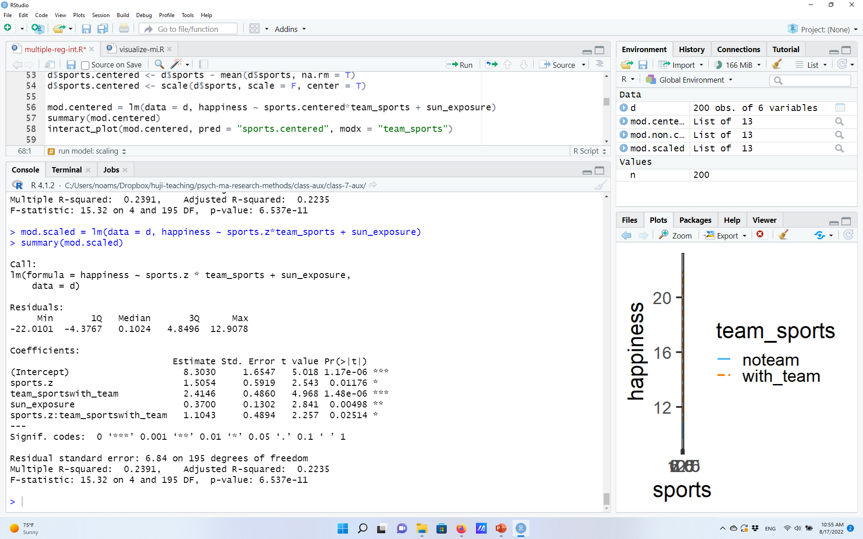
Centering vs. scaling (i.e., Z-transformation)
Scaling=Z-transformation: Inserting continuous variables to model as Z scores.
Equivalent outcomes…
Centered model (centered predictors)
Scaled model (Z-transformed predictors)
Centering and Scaling lead to same t and p values
But estimates (B, SE) do differ: Scaling: Estimated change in DV as a function of one SD; Centering: change in raw units.

Slide 21
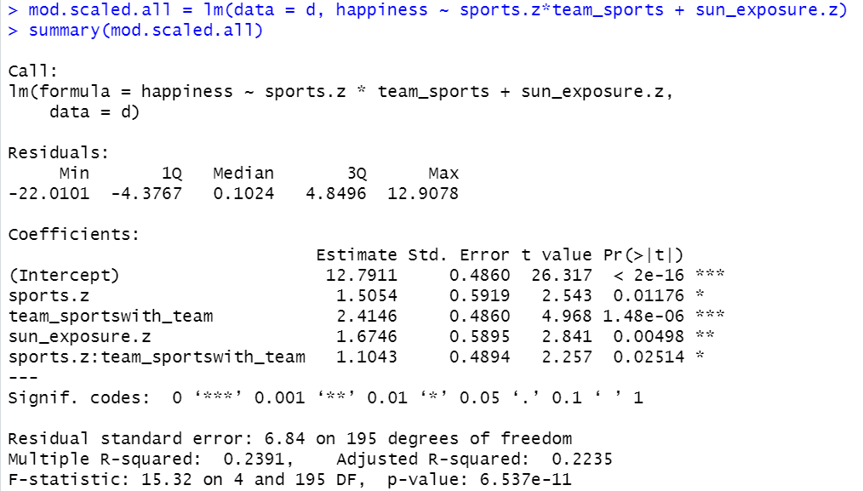
One more advantage of centering/scaling
When all variables are centered or scaled, the intercept estimates the mean DV level at the grand mean (average of all other variables).
Descriptively useful.
Sometimes (not often, not never) statistically useful: Statistical test of whether mean performance is larger than 0.
E.g., is mean performance different than chance level?

Slide 22
The bottom line
Unless you have a very good reason to do otherwise, when you have interactions in your model make sure all predictors are centered.
This ensures that the interpretation of a main effect’s coefficient is the effect of the variable at the grand mean of other variables.
In practice:
Make sure that numeric variables have a mean of 0 (=either centered or scaled).
Make sure categorical variables are effect-coded.
Remember, that’s not R’s default!

Slide 23
One more reason to center: Reduce artificial collinearity
There’s also another good reason to center all variables: It often reduces artificial collinearity in the model. In tutorial.

Slide 24
One-final note: No matter what you do, be clear about it!
You’d be surprised by how rarely people report their models properly…
Brehm & Alday, 2022, JML
Instead, provide all details:
BAD: “we ran a multiple regression predicting happiness from number of hours of physical activity, type of physical activity, hours of activity by type of activity interaction, and hours of sun exposure”
GOOD: “we ran a multiple regression model, with happiness (from the XXX questionnaire) as the dependent variable. Independent variables were number of hours of weekly physical activity (Z-transformed), type of activity (with vs. without group, effect-coded, without group set as -1), and their interaction. Hours of sun exposure per week (raw values) was entered as a control variable.”
Plus, provide your analysis code as Supplementary Materials. Always a good idea.

Slide 25
Transformations of independent variables And comparison of non-nested models

Slide 26
Transformations of independent variables
Centering and scaling are just one type of predictor transformation.
A transformation that is done, primarily, for statistical reasons.
There are many other types of common transformations applied to independent variables.
Some are done for statistical reasons, some done for theoretical reasons.
Two common examples:
1) Quadratic regression.

Slide 27
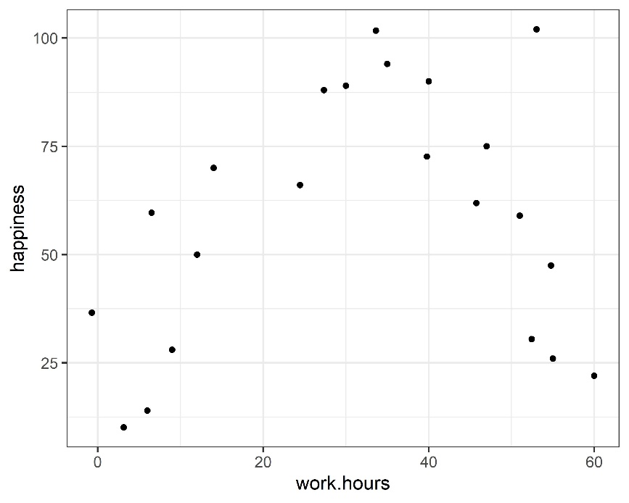
Quadratic model example: Work hours and happiness

Slide 28
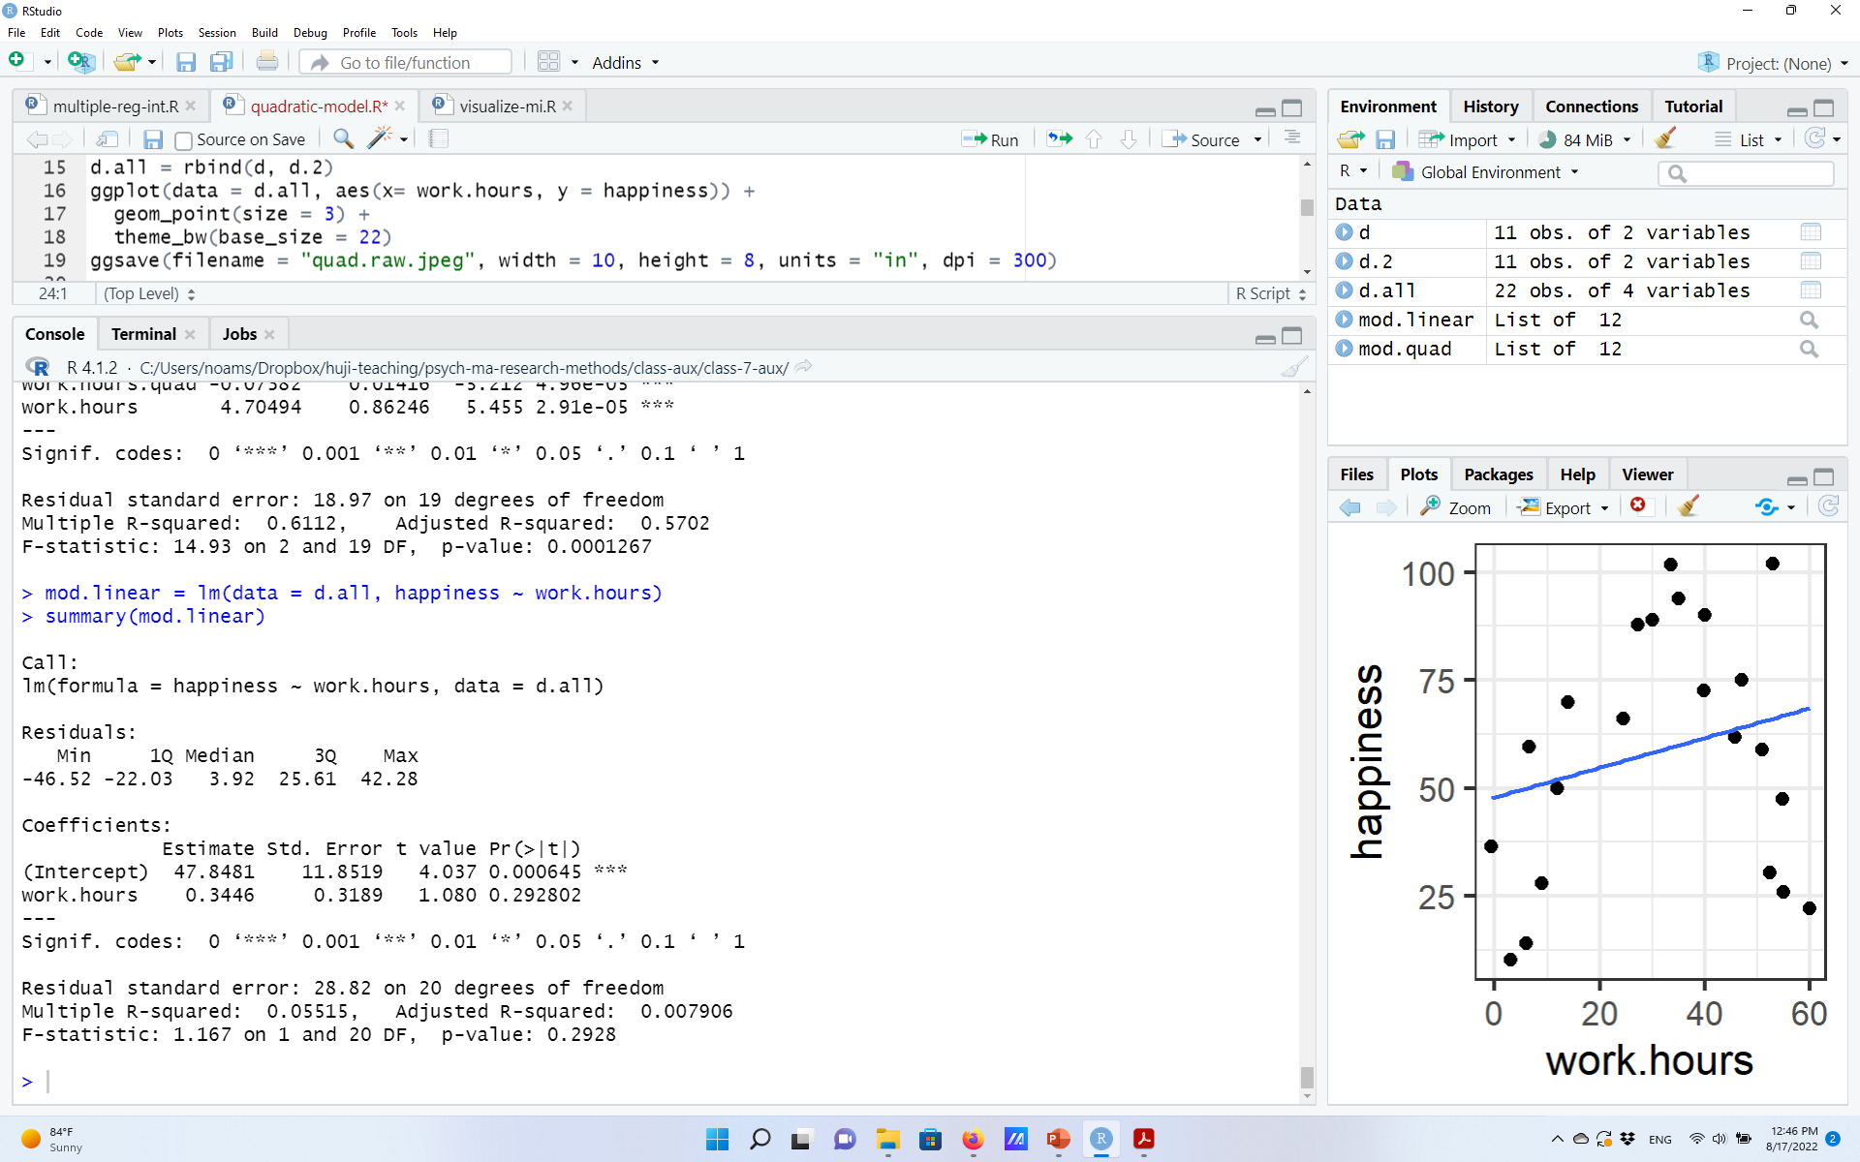
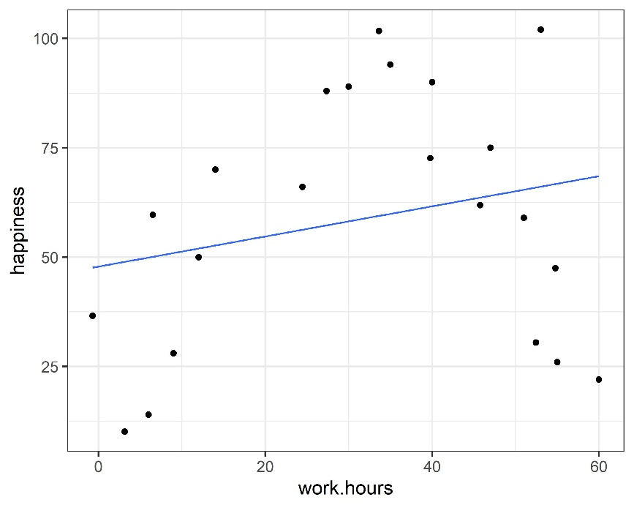
Quadratic model example: Work hours and happiness
Fitting a linear model: Probably not a good idea…
Unsurprisingly, pretty bad fit ($R^{2}$), insignificant linear relation.

Slide 29
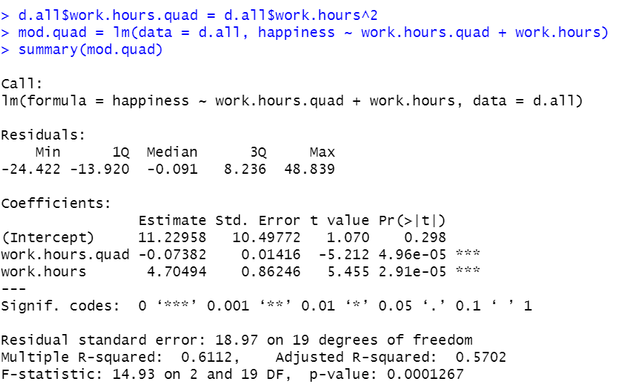
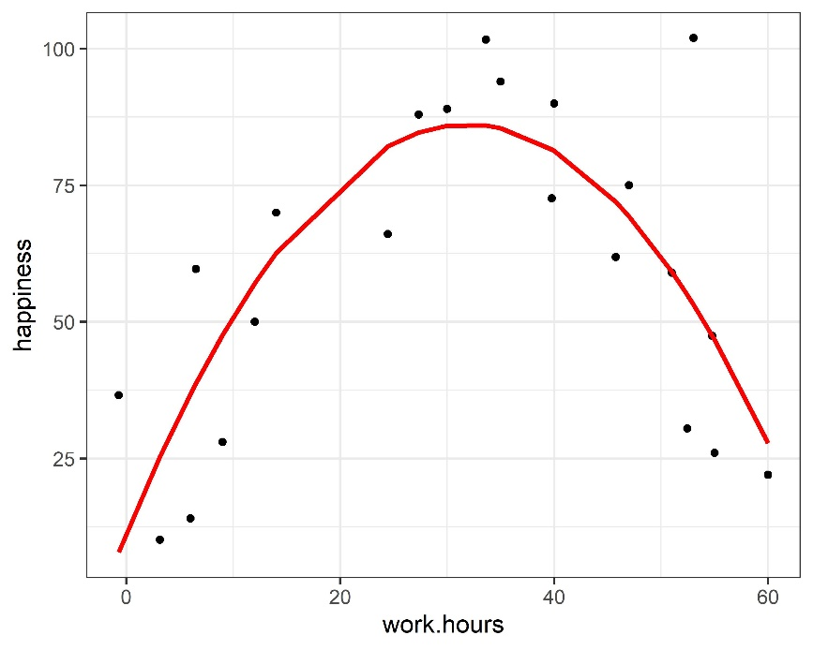
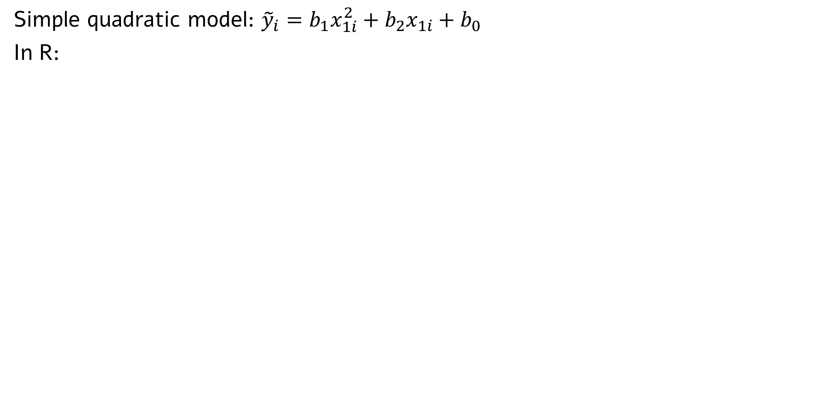
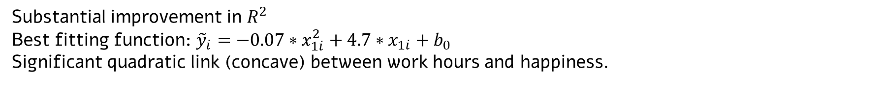
Quadratic model example: Work hours and happiness
Simple quadratic model: ${\tilde{y}}_{i}=b_{1}x_{1i}^{2}+b_{2}x_{1i}+b_{0}$
In R:
Substantial improvement in $R^{2}$
Best fitting function: ${\tilde{y}}_{i}=−0.07∗x_{1i}^{2}+4.7∗x_{1i}+b_{0}$
Significant quadratic link (concave) between work hours and happiness.

Slide 30
A general note: Transformations of independent variables
Centering and scaling are just one type of independent variable transformation.
A transformation that is done, primarily, for statistical reasons.
There are many other types of common transformations applied to independent variables.
Some are done for statistical reasons, some done for theoretical reasons.
Two common examples:
Quadratic regression.
Log-transformation.

Slide 31
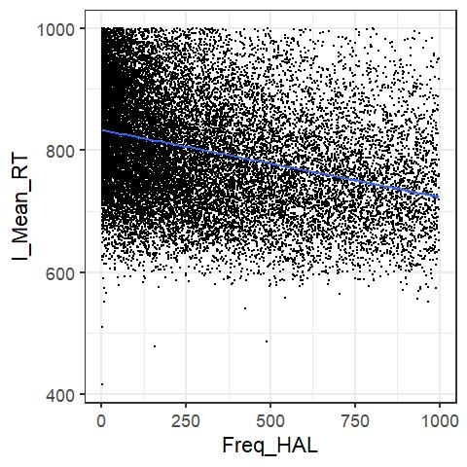
Log-transformation example: Word frequency effect
More frequent words are read faster and more accurately.
But apparently, the link is not fully linear.
Data from the English Lexicon Project, Balota et al., 2007

Slide 32
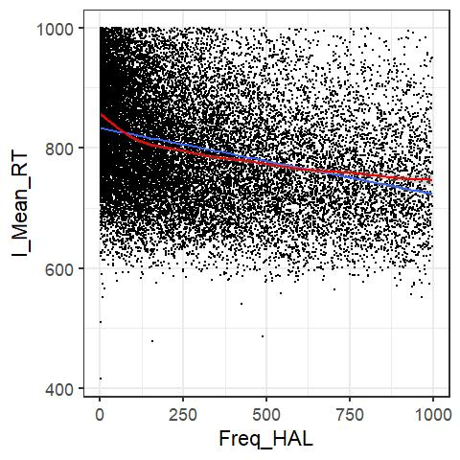
Log-transformation example: Word frequency effect
More frequent words are read faster and more accurately.
But apparently, the link is not fully linear.
Data from the English Lexicon Project, Balota et al., 2007
Better* described as a log-linear link.
(*probably still not be perfect, may be even log-log (more later)).

Slide 33
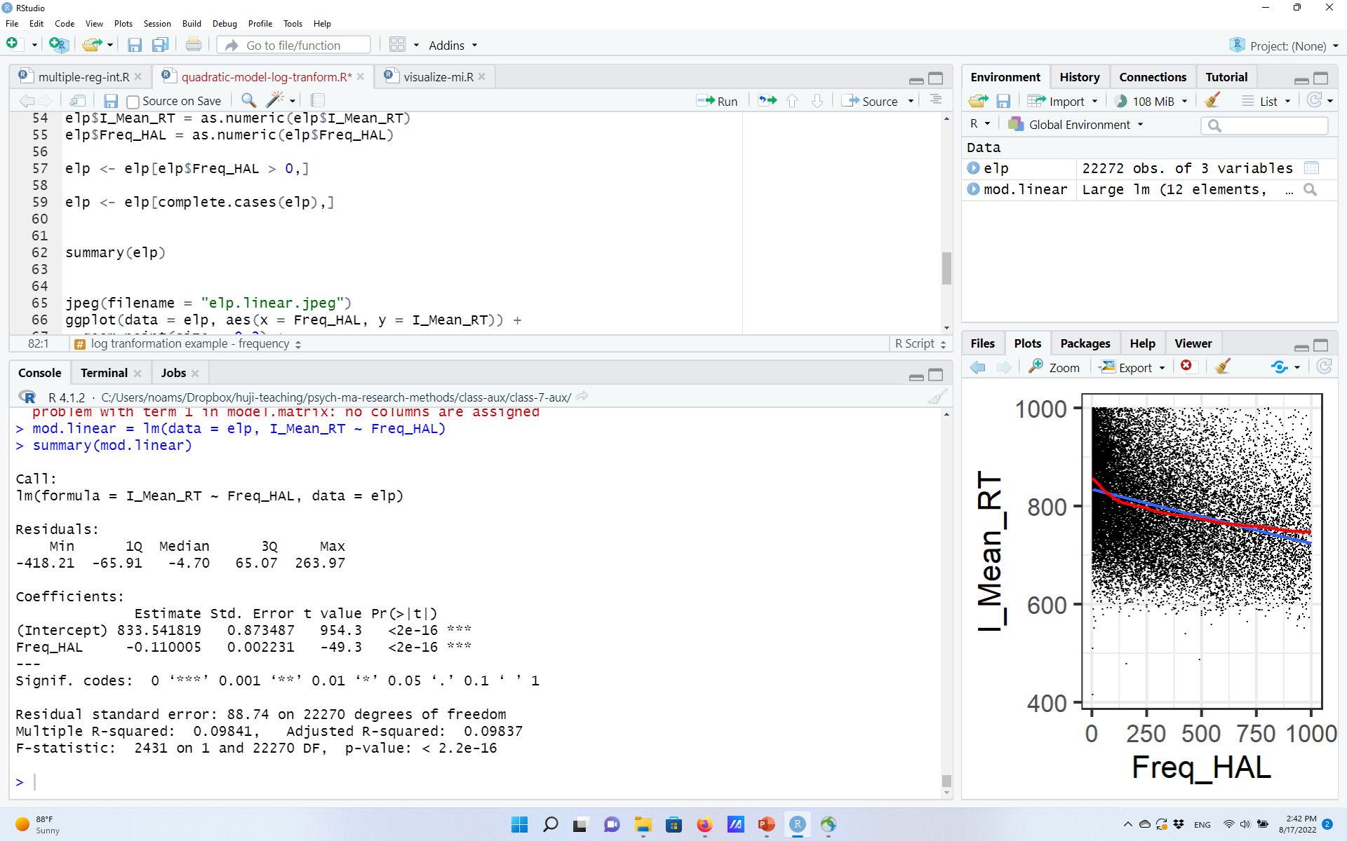
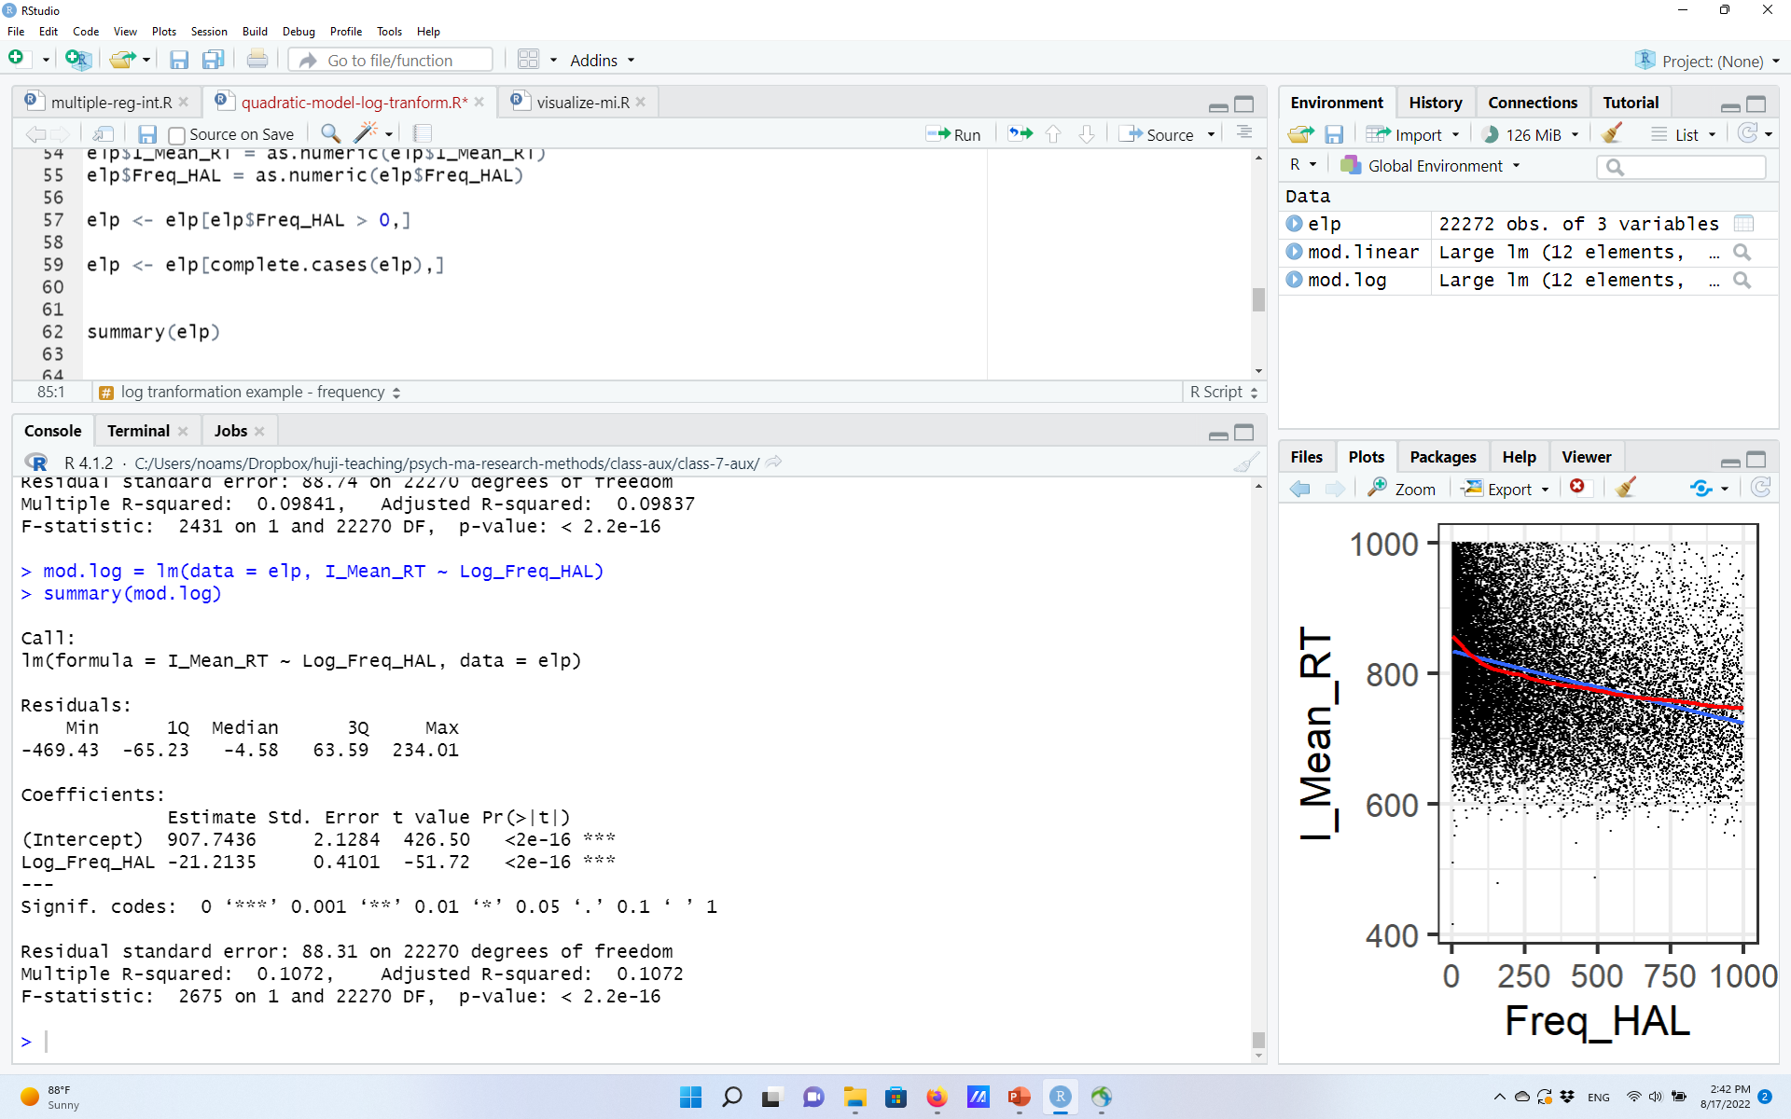
Log-transformation example: Word frequency effect
Raw frequency model
Log-transformed frequency model
Slightly higher R²… but how to choose between the two models?

Slide 34
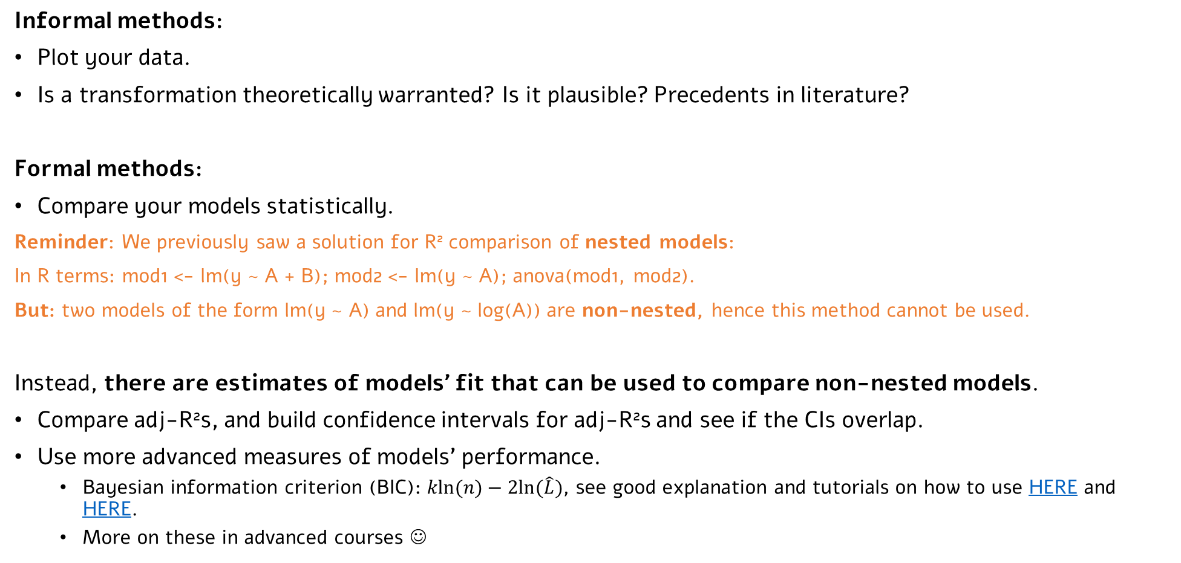
To transform or not to transform?
Informal methods:
Plot your data.
Is a transformation theoretically warranted? Is it plausible? Precedents in literature?
Formal methods:
Compare your models statistically.
Reminder: We previously saw a solution for R² comparison of nested models:
In R terms: mod1 <- lm(y ~ A + B); mod2 <- lm(y ~ A); anova(mod1, mod2).
But: two models of the form lm(y ~ A) and lm(y ~ log(A)) are non-nested, hence this method cannot be used.
Instead, there are estimates of models’ fit that can be used to compare non-nested models.
Compare adj-R²s, and build confidence intervals for adj-R²s and see if the CIs overlap.
Use more advanced measures of models’ performance.
Bayesian information criterion (BIC): $kln(n)−2ln⁡(\hat{L})$, see good explanation and tutorials on how to use HERE and HERE.
More on these in advanced courses ☺
Notes:
More advanced measures are based on the model’s maximum likelihood (p(data | model), $\hat{L}$), and typically penalizes for number of model’s parameters (k)

Slide 35

Think about transforming, But always beware over-fitting!
Source: Wikipedia
Blue trendline has the better fit, but is it really how we want our model to look like?

Slide 36
A useful approach: Cross-validation
Split your data into two (commonly: 50-50%): Use one set for coming up with predictions of transformations (e.g., y ~ log(x)+x^3), use the other part for re-testing them.
Prevents over-fitting: Increased fit in “test” set only possible if not due to over-fitting.
A variety of formal methods, very common especially in highly complex models (e.g., machine learning, neural networks).
If you work in a field with lots of potential non-linearities, learn more about Generalized Additive Models, which (conceptually) uses some built-in penalty for more complex models (GAMs; e.g., here).

Slide 37
Logistic regression

Slide 38
Beyond numeric DVs
We now know how to code categorical variables, and transform various predictors, to include them in regression models, both additive and interactive.
We can now have many different types of predictors in our model, yay!
But we still do not know how to deal with dependent variables other than continuous variables.
Common cases:
Ordinal data (e.g., how friendly are you? Not at all < a little < a lot < super)
Count data (e.g., how many times have you visited a doctor? 0, 1, 2, … 5)
Binomial data (e.g., are you in therapy (yes/no)? Do you own a car (yes/no)? Success in answering (1) question (correct/incorrect)? Did each participant commit a mock crime (yes/no)?)

Slide 39
Beyond numeric DVs
We now know how to code categorical variables, and transform various predictors, to include them in regression models.
But we still do not know how to treat other types of dependent variables.
Common cases:
Ordinal data (e.g., how friendly are you? Not at all < a little < a lot < super)
Count data (e.g., how many times have you visited a doctor? 0, 1, 2, … 5)
Binomial data (e.g., are you in therapy (yes/no)? Do you own a car (yes/no)? Success in answering (1) question (correct/incorrect)? Did each participant commit a mock crime (yes/no)? Presence of some condition/disease (yes/no)?)
Let’s start from a ‘simple’ (i.e., one predictor) logistic regression, for simplicity.

Slide 40
Simple logistic regression example: dative alternation
In many languages, there is the so-called “dative alternation” phenomenon:
The boy gave the girl an apple
The boy gave an apple to the girl
What makes speakers produce one of the two options?
One factor is the length of the recipient – we predict that as the length of the phrase describing the beneficiary (=recipient) of the action is longer, we expect it to be realized at the end of the sentence.
To check our hypothesis, we sampled 3263 sentences from an English corpus.

Slide 41
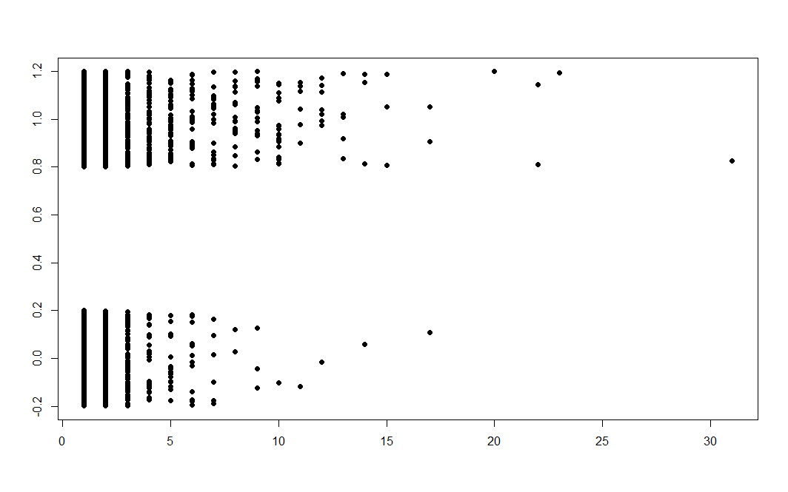
Simple logistic regression example: dative alternation
End of
Sentence (1)
Realization of recipient
Near
Verb (0)
Length of recipient
Data from the LanguageR package

Slide 42
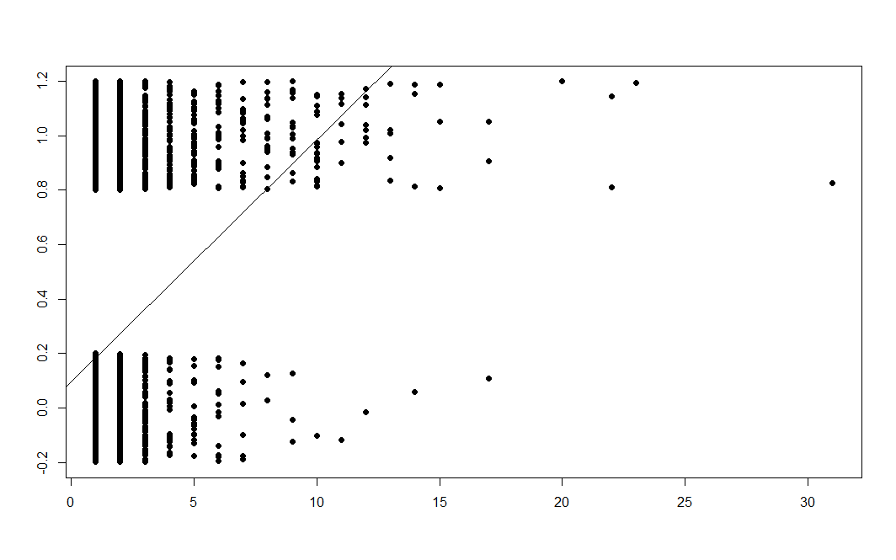
Simple logistic regression example: dative alternation
A simple linear model doesn’t make sense – it fits the data poorly, predicts values smaller/larger than 0/1, and violates the model’s assumptions.
End of
Sentence (1)
Realization of recipient
y = 0.096 + 0.089*x
Near
Verb (0)
Length of recipient
Data from the LanguageR package

Slide 43
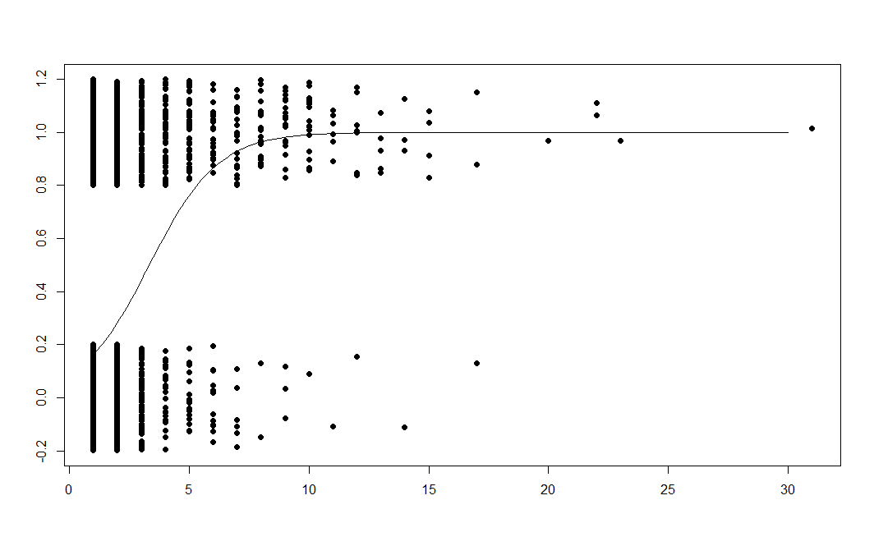
Simple logistic regression example: dative alternation
Instead, in logistic regression, we fit a sigmoid that predicts the probability of y=1 given x (in our case, the probability of the recipient realized as ‘end of sentence’ given its length).
P(End of
Sentence) = 1
Probability of realization of recipient at end of sentence
But how did we get to this optimal line?
P(End of
Sentence) = 0
Length of recipient
Data from the LanguageR package

Slide 44
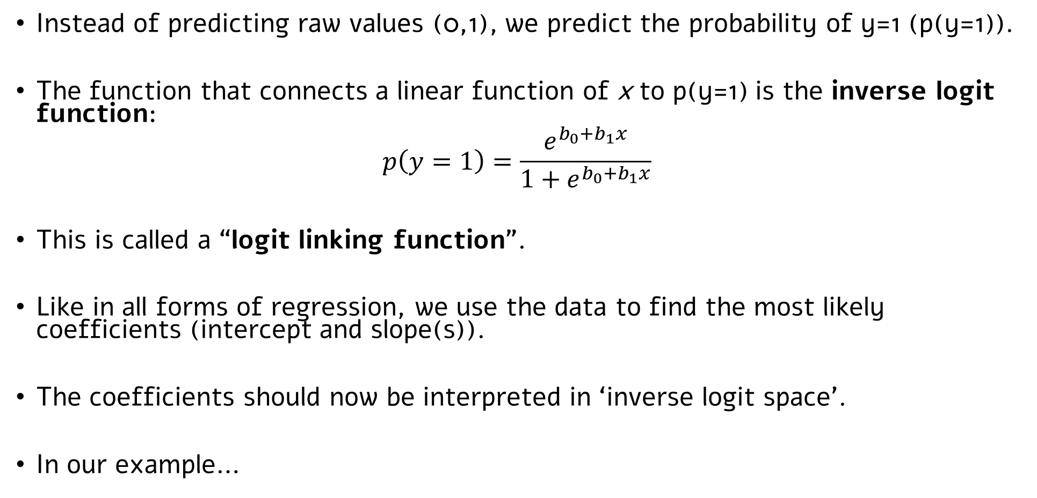
Simple logistic regression
Instead of predicting raw values (0,1), we predict the probability of y=1 (p(y=1)).
The function that connects a linear function of x to p(y=1) is the inverse logit function:
$$p\left(y=1\right)=\frac{e^{b_{0}+b_{1}x}}{1+e^{b_{0}+b_{1}x}}$$
This is called a “logit linking function”.
Like in all forms of regression, we use the data to find the most likely coefficients (intercept and slope(s)).
The coefficients should now be interpreted in ‘inverse logit space’.
In our example…

Slide 45
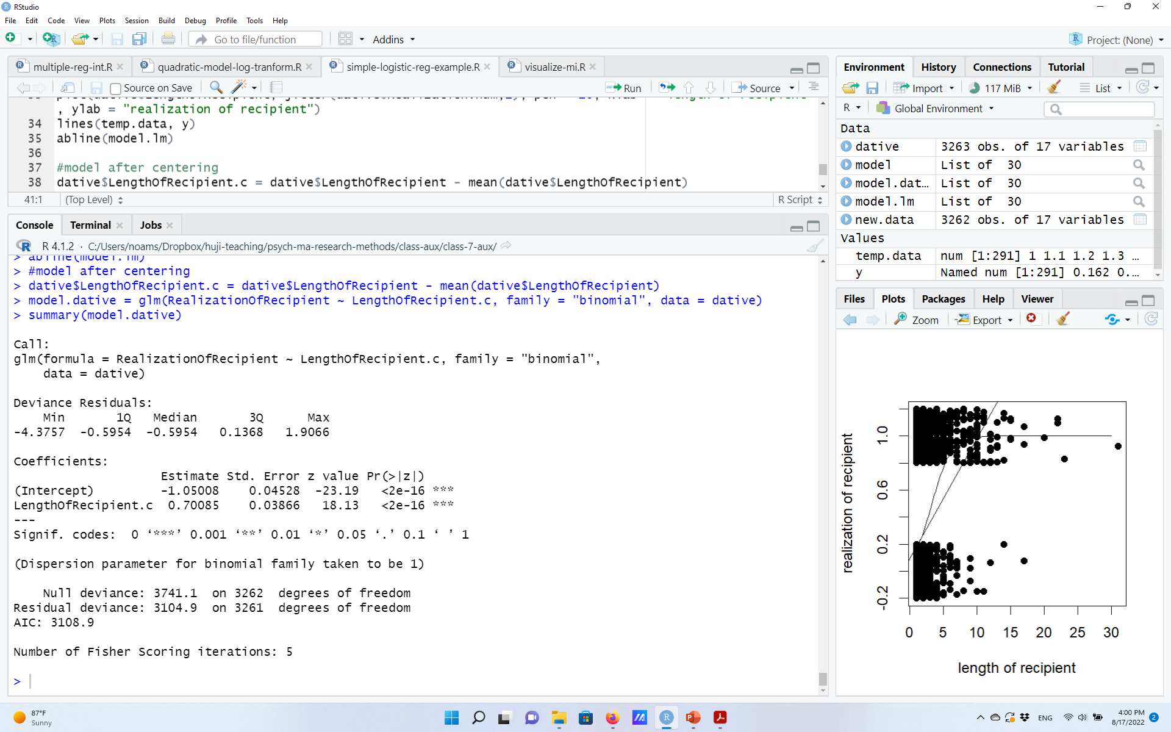
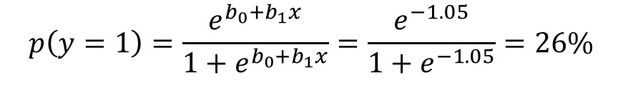
Simple logistic regression in R
Interpretation of intercept (other variables are centered):
$$p\left(y=1\right)=\frac{e^{b_{0}+b_{1}x}}{1+e^{b_{0}+b_{1}x}}=\frac{e^{−1.05}}{1+e^{−1.05}}=26\%$$
On average, in 26% of the sentences the recipient is realized at the end of the sentence
(a number significantly different than 50% = $\frac{e^{0}}{1+e^{0}}$)

Slide 46
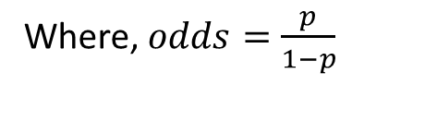
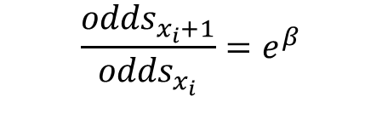
Simple logistic regression in R
Interpretation of slope(s):
In our case (b=0.70):
e^{0.7} = 2.01
For every increase of 1 word in the length of recipient, the odds of the recipient realized at the end of the sentence increase by 2.01.
… A change that is significantly different than no change in odds.
It can be shown that beta can be interpreted as follows:
$$\frac{{odds}_{x_{i}+1}}{{odds}_{x_{i}}}=e^{β}$$
Where, $odds=\frac{p}{1−p}$
Notes:
Say moving from the intercept (centered length of recipient = 0) to 1 above the mean.
The odds change by 2.01.
Odds on average – 0.26/0.74 = 0.35
Odds in x=1 are therefore 35%*2.01 = 0.7
That means that:
p/1-p = 0.7
Therefore p is 41%

Slide 47
From simple to multiple logistic regression
Everything* else that we know about multiple regression still holds!
E.g.,
Interpretation of coefficients in multiple regression, and what does it mean to control for a variable.
I.e., multiple logistic regression – just add more predictors to the model!
How to code categorical independent variables and include them as predictors.
How to interpret interactions, and why it’s important to center/scale predictors...
(*with the exception of measures of overall model fit. If that’s relevant, come see me ☺)

Slide 48
Two general notes
1) Logistic models are a subset of other types of Generalized Linear regression models.
E.g., counts and ordinal variables.
The idea is the same – instead of using a function that links x to y linearly, connect x linearly to some other variable derived from y (e.g., inverse logit of y in logistic regression).
A “trick” that allows us to still use what we know from “regular” linear models.
(Generalized linear models differ from “fully” non-linear models, which allow you to search for non-linearities without pre-defining a linking function. If interested, see here for Generalized Additive Models).
2) Although not non-existent, binary DVs are not very common. But logistic models are going to become very useful soon when we’ll talk about logistic mixed-effect models.

Slide 49
Beyond two-way interactions A quick note

Slide 50
Beyond two-way interactions
Regression allow you to easily include higher-level interactions (3-way, 4-way …).
Although they should be clearly justified, sometimes they are useful.
(Equivalent) Interpretations of a 3-way interaction (y ~ A*B*C):
The effect of the two-way interaction on Y (e.g., A*B) varies as a function of the levels of the third-variable.
Specific combinations of values of A, B, and C lead to specific increase/decrease in Y.

Slide 51
Beyond two-way interactions
Three-way interactions are relatively common (non-exhaustive list!)
In experimental designs, when an effect of interest is reflected in a two-way interaction, and one wants to see whether it varies further as a function of another variable.
The “basic” effect: Words that are less consistent (PINT) are read slower than consistent words (MINT), but only when words are not frequent. Follow-up three-way interaction questions: Does this two-way interaction changes when words presented in isolation vs., sentences? Does it vary between languages?
In correlational designs, when we are interested in more intricate relations between multiple variables.
E.g., the two-way interaction between sport hours and team sports is modulated by gender: E.g., present in men, but less so in women.

Slide 52
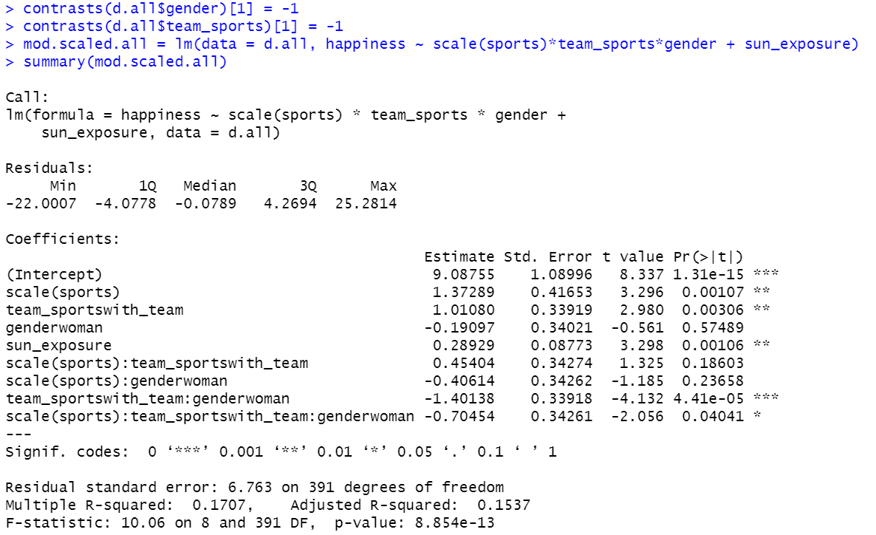
A model with a three-way interactions
Imagine that all ‘happiness’ data so far were from men, and now we include N=200 more women to the sample.
Everything we know about scaling, centering, coding, still holds!
A significant three-way interaction

Slide 53
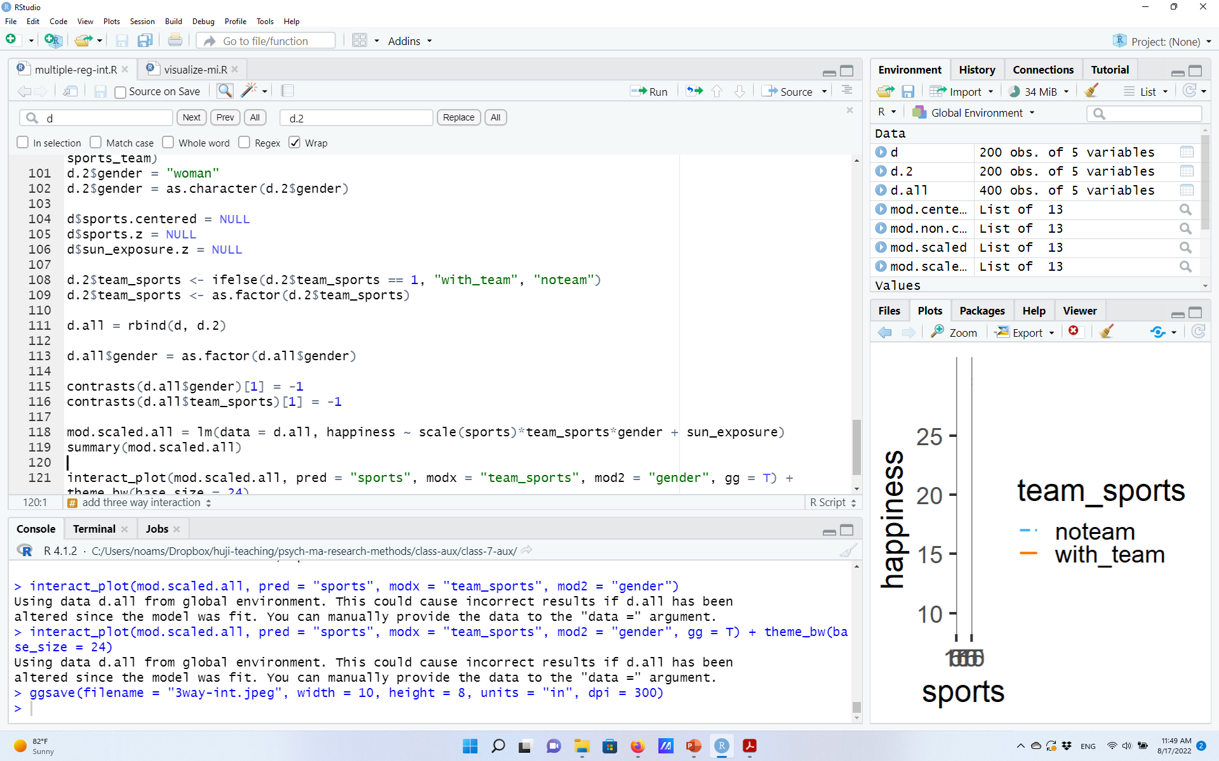
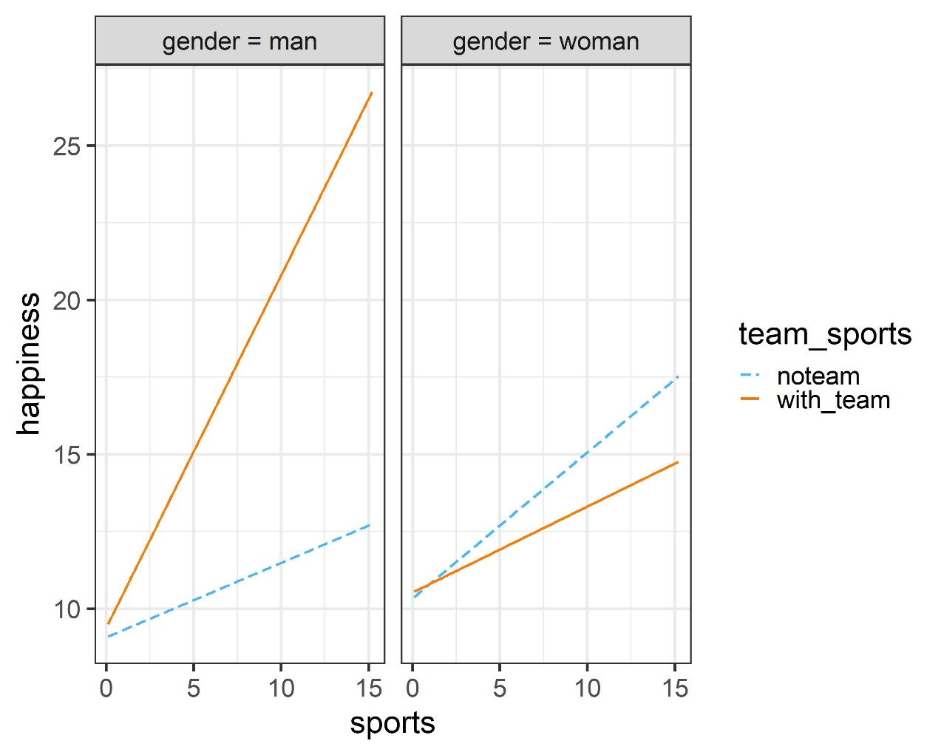
A model with a three-way interactions
But not much of an interaction (if anything, slightly “flipped”) among women.
A similar two-way interaction we saw before among men.
How would you further test (statistically) the source of the 3-way interaction?

